Slide 1


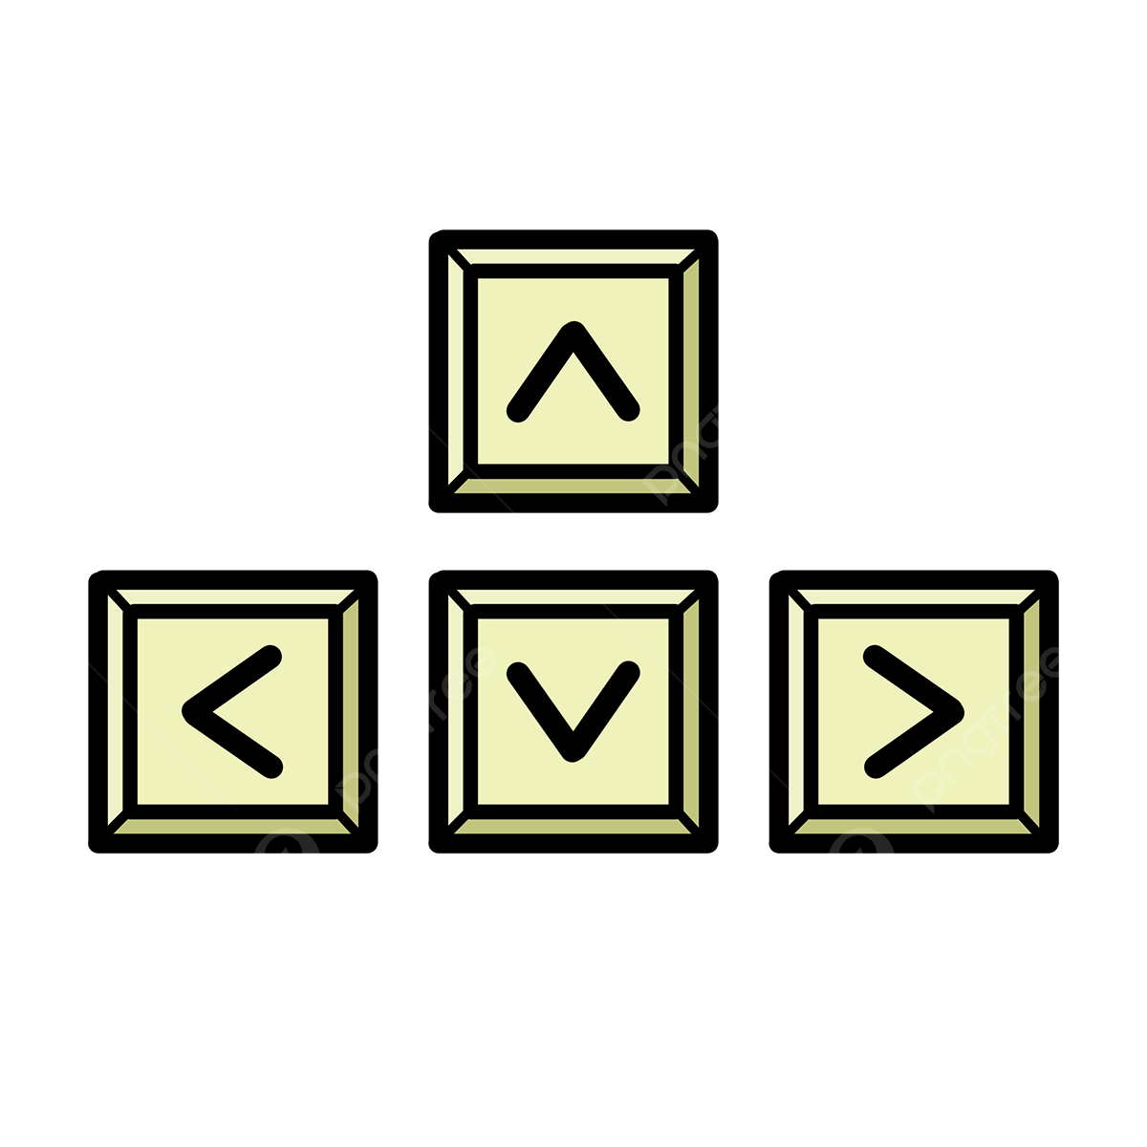
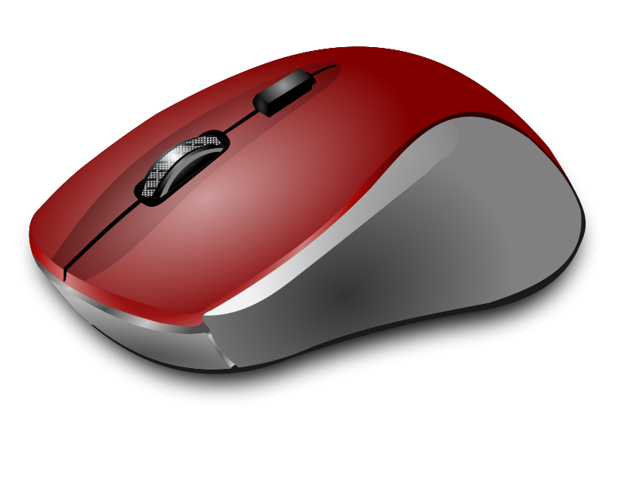
Keyboard and Mouse Input
ICS2O/ICD2O Workshop

Slide 2
Table of contents
01
02
03
Keyboard
Mouse
Controlling your program with the press of a button!
All you can do with mouse clicks and presses!
Practice
Get your hands dirty—or, rather, snowy—with some practice!

Slide 3
01
Keyboard Input
qwertyuiopasdfghjklzxcvbnm

Slide 4

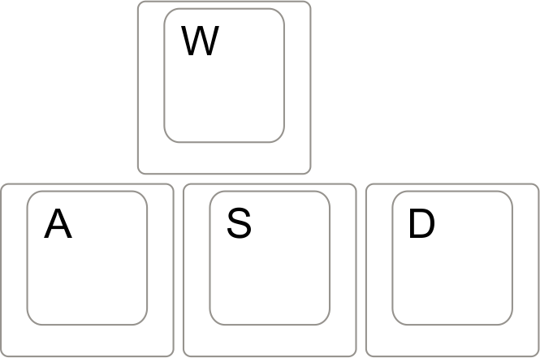
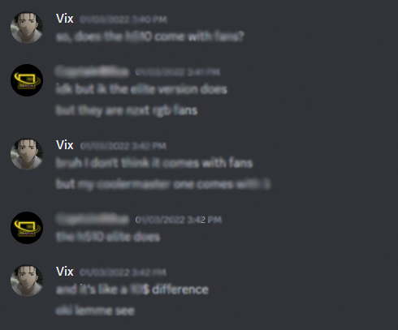
Where do we see keyboard input?
Writing your essays
Playing video games
Texting friends
Notes:
“Why do we need keyboard input?”

Slide 5
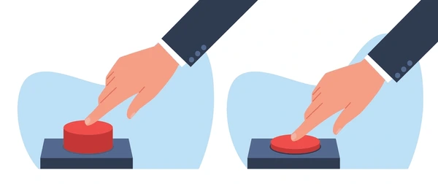
We can put keyboard input into 2 categories
THE PRESSING
THE RELEASE
Happens constantly
Happens only once

Slide 6
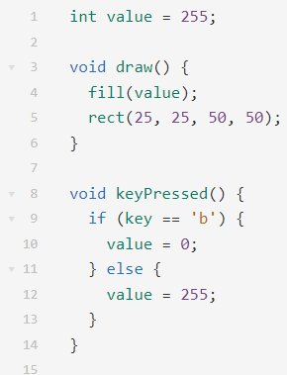
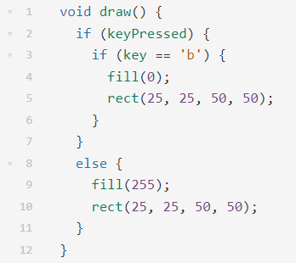
THE PRESSING
Notes:
Code is suboptimal on purpose. Easier to understand

Slide 7
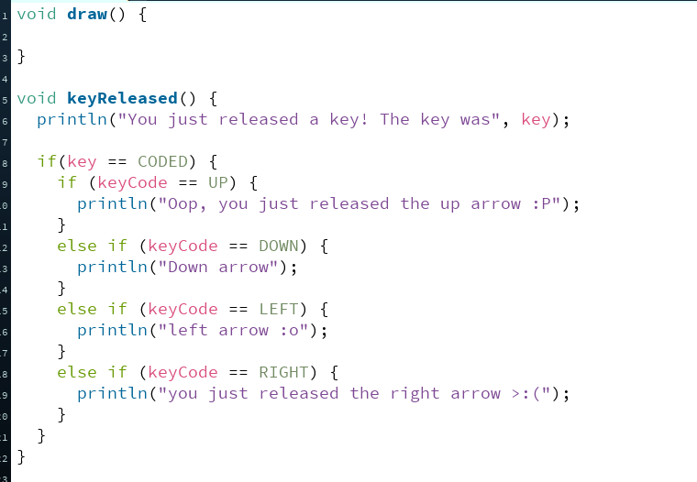
THE RELEASE
Notes:
Code is suboptimal on purpose. Easier to understand

Slide 8
02
Mouse Input
Click click click click click click click click click click click click click click

Slide 9

Mouse Input
Having your code react to mouse input can be useful for
Buttons
Games
Much more!
So how can we make our code detect mouse input?

Slide 10
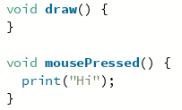
mousePressed()
Runs whenever the mouse is pressed
IMPORTANT!
Notice draw()?
mouse/key functions
CAN’T RUN WITHOUT IT
Without it program only runs 1 time (only checks for input once)
Every time the mouse is pressed, program will print “Hi”

Slide 11
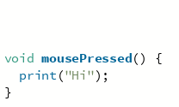


draw() is very important!!!
vs
With draw:
Without draw:
Pressing mouse x5 -> x5 “Hi”s!
Doesn’t print anything :(

Slide 12



mouseClicked()
Runs after mouse is PRESSED and RELEASED
Press mouse with no release:
Press mouse and then release:
NOTE: only counts if mouse is pressed and released in the same place

Slide 13
mouseClicked() vs mousePressed()
mousePressed()
mouseClicked()
Runs when mouse is PRESSED
Runs after mouse is both PRESSED and RELEASED

Slide 14
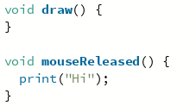
mouseReleased()
Runs when the mouse is RELEASED
(woahh did not see that coming frfr)
Press mouse:
Release mouse:

Slide 15

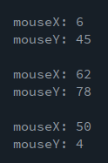
mouseX & mouseY
These are Processing's built-in to tell you where the user's mouse is on your output screen!
mouseX: x-coordinate of mouse
mouseY: y-coordinate of mouse
It's super useful for on-screen buttons and in general when you want something to happen only if the user clicks on a specific region.
Shows us the coordinates of the mouse on the canvas!

Slide 16
03
Practice!
Try out your new mouse and keyboard input skills on a cute little snowman :)

Slide 17

Problem 1
Write some code that will move the snowman left or right when the user presses the left and right arrow keys.
Make sure you are using the integer variables x and y because these are the variables that control the snowman's position.
tinyurl.com/snowmanmcpt2023

Slide 18
Problem 2
Write some code that will change the snowman's top hat colour from grey to green when the user clicks their mouse.
For this particular program, make sure you use the integer variables hatColourR, hatColourG, and hatColourB (corresponding to RGB).
tinyurl.com/snowmanmcpt2023
(In other programs, you could normally just use a color variable. This program uses three integer variables instead of just one color variable because the hat has two shades.)

Slide 19
Challenge Problem!
Create a colour palette on the side of the screen with 5 colours of your choice. Write some code so that if the user clicks on a certain colour and then the snowman's hat, the snowman's hat becomes the colour that the user clicked on.
Remember to use the integer variables hatColourR, hatColourG, and hatColourB for controlling the hat colour.
tinyurl.com/snowmanmcpt2023

Slide 20
Thank you so much for coming!

